Slide 1
AS91896(2.7) & AS91887(2.8) Documentation
Josh Currie-Cook

Slide 2
[Overtype this with your program name]
Link to GitHub Repository: Joepapa101/2.7---2.8-Assessment (github.com)
Links to Trello board / project management tools: Monster Card Decomposition | Trello
Link to final version of your program:

Slide 3
Explain relevant Implications:
Relevant implication | Describe the implication and give an example
Useability | The program needs to be useable by less-experienced computer users. For example, a less computer-experienced person should know how to use the program as soon as they see it, and this is done by making the program easy to use.
Practicality | For the program to be practical, it needs to have clearness so that the user knows what to do. For example, what data the user is entering needs to be used in someway rather than a button or an input that does nothing.
Accessibility | The program needs to be easy to access and use by anyone. As the program’s user interface is Easy GUI, this means the program is basic to the end user, as well as being as practical as the command line in this program. For example, navigating through the program should be done by anyone.
Stability | A bug free experience is important, meaning the program wont break down randomly. For example, the program needs to have been thoroughly tested to ensure it is stable
Reliability | The program needs to accept some level of human error without crashing for example if they enter a letter instead of a number
Additional rows can be added by clicking in the last cell and then using the Tab key
Notes:
Additional rows can be added by clicking in the last cell and then using the Tab key

Slide 4
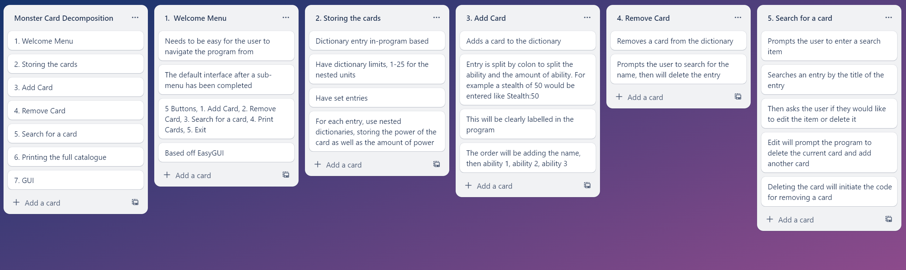
Decomposition:
Paste screenshots of your initial Trello board / task decomposition on this slide. If you have a long list, you might need to break it up into several slides.
Notes:
Paste screenshots of your initial Trello board / task decomposition on this slide. If you have a long list, you might need to break it up into several slides.

Slide 5
Add entry

Slide 6
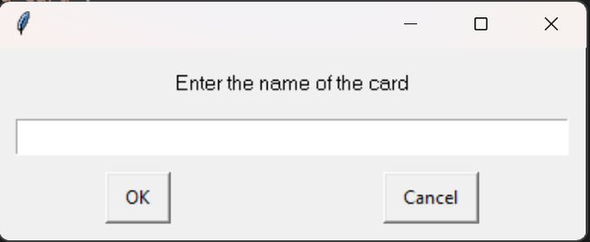
Component – Add entry
In the component ‘Add entry,’ a dictionary entry needs to be inputted successfully by the user into the ‘monster cards’ catalog to be stored by the program

Slide 7
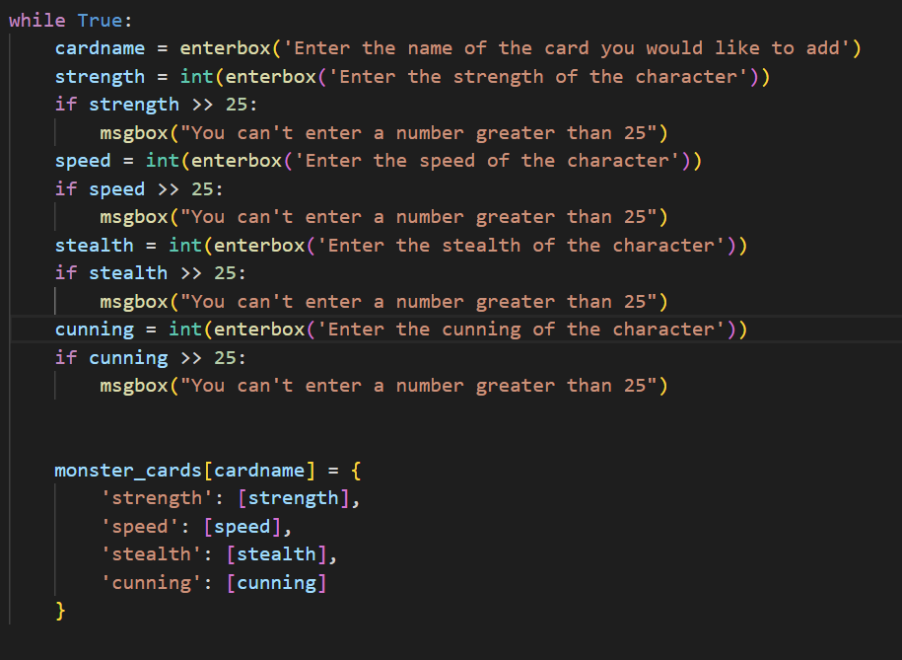
Add item : Trialling
What I wanted the code to do is throw an error everytime the user entered a number bigger than 25. I started off by using the >> operater because I thought that’s how you were supposed to phrase it. To my surprise, the program threw up no errors, no matter how big I made the numbers
NOTE: Trialling needs to happen for at least 2 of your components but is not necessary for ALL components.
Trialling is not the same as testing. Trialling is about finding different ways of building the same component. Show evidence of your trialling here. Select one of your trials for further development and give reasons for your choice.
Notes:
NOTE: Trialling needs to happen for at least 2 of your components but is not necessary for ALL components.
Trialling is not the same as testing. Trialling is about finding different ways of building the same component. Show evidence of your trialling here. Select one of your trials for further development and give reasons for your choice.

Slide 8
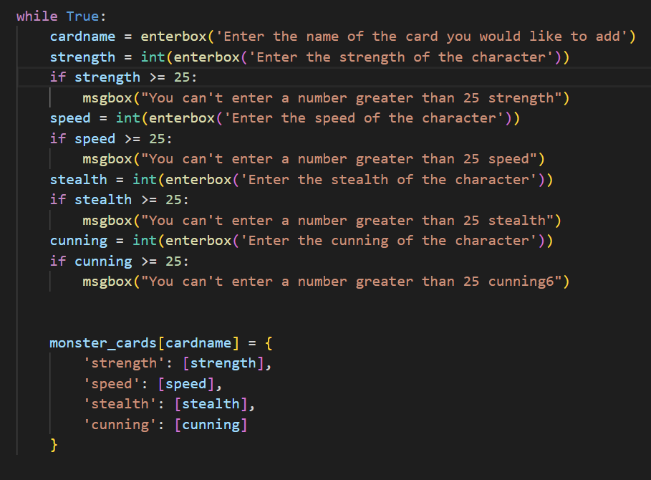
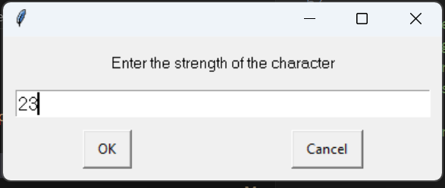
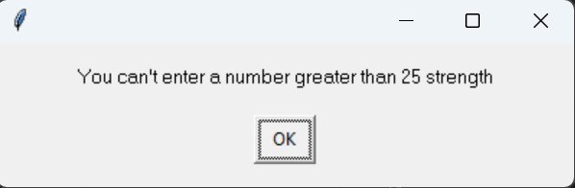
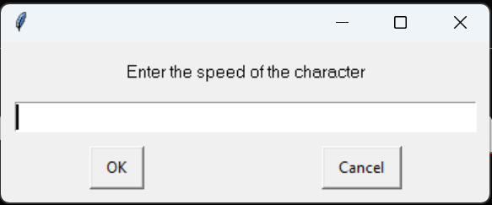
Add item - Trialling
I added an above-equal sign and that fixed the problem, however it was not letting the user go back and edit their wrong number

Slide 9
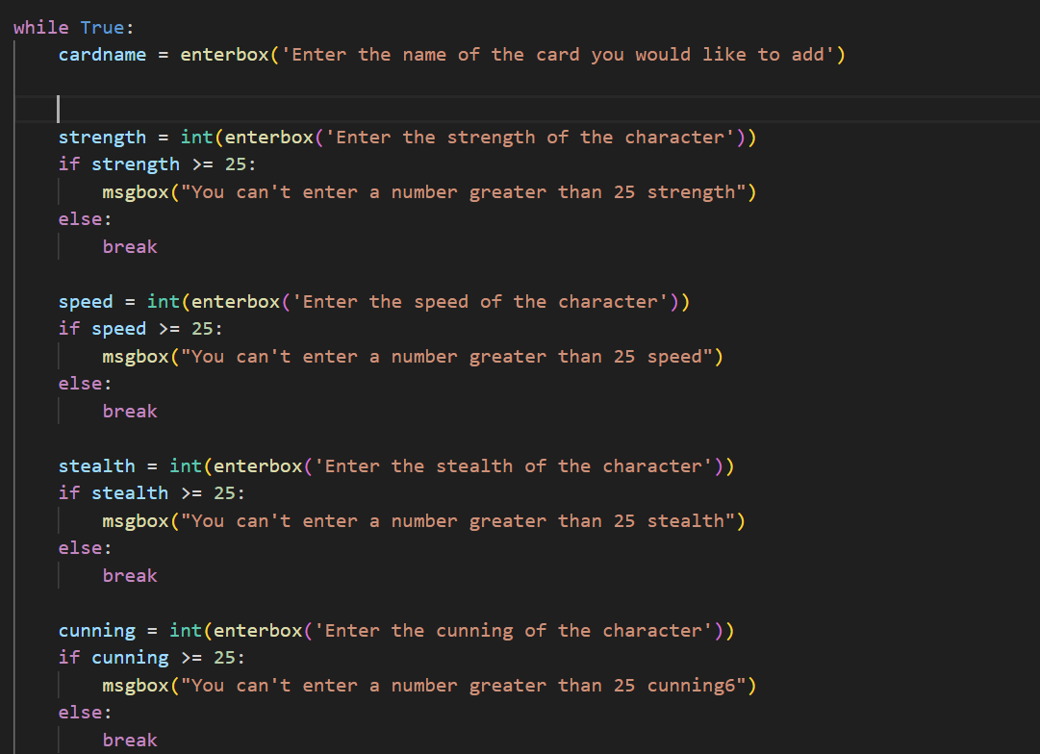
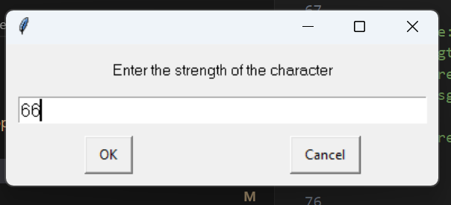
Add item - Trialling
I also trialled using an else: command to try and make sure it would go back to the previous command, however the same result occurred, and if I entered a number above 25 for ‘strength,’ it would say I had the wrong number and carry on to ‘speed’

Slide 10
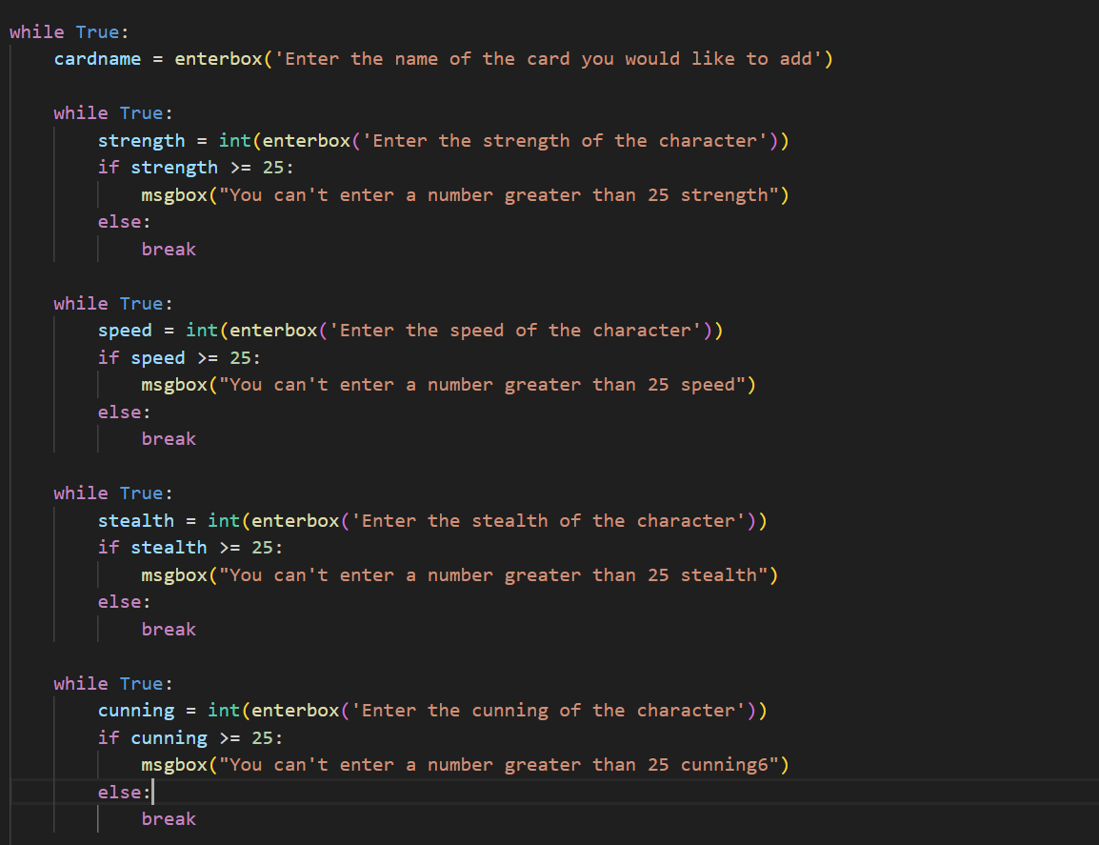
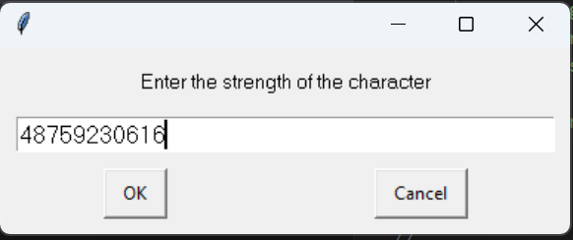
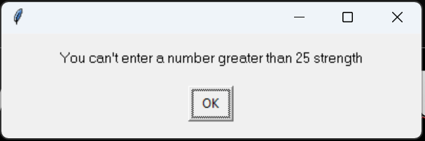
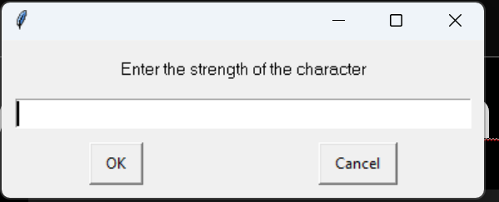
Add item - Trialing
In version 3 of the program, I added a ‘while true’ loop to each individual ability. The outcome was exactly as intended, with the program spitting out an error to the user saying the number cannot be greater than 25, and repeating the command just prompeted instead of going to the next one

Slide 11
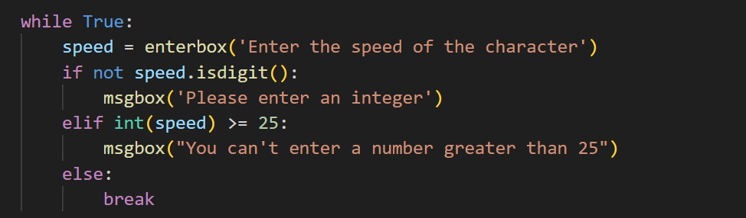


Add item – Trialling (v4)
In version 4 of the program, I added the condition .isdigit to ensure that if the user adds a letter by accident to the program, the program will not crash. This ensures the implications ‘stablity’ and ‘reliability’ are being met by the program not crashing if the user inputs the wrong letter instead of a number.

Slide 12
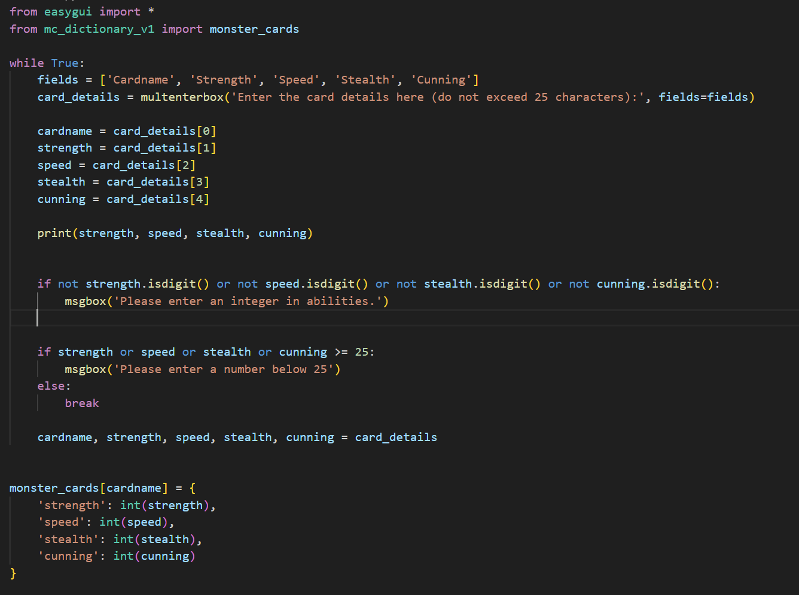
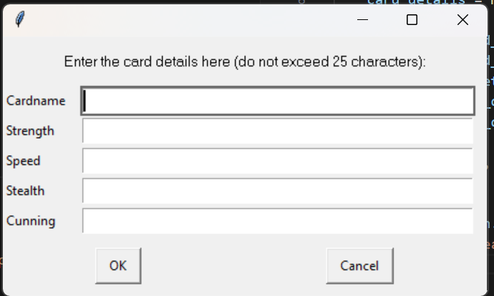
Add item – v5
multenterbox
In version 5 of the program, I decided to opt for the multenterbox because it made more sense for multiple entries. The same >25 and integer only limits applied, however since all of the data is being entered at once, all of the data is wiped and the user has to enter it again.
Variables that split the data from the multenterboxes into different items
Integer checker to make sure the user hasn’t’ entered a letter
Number checker, to make sure the user has entered a number below 25

Slide 13
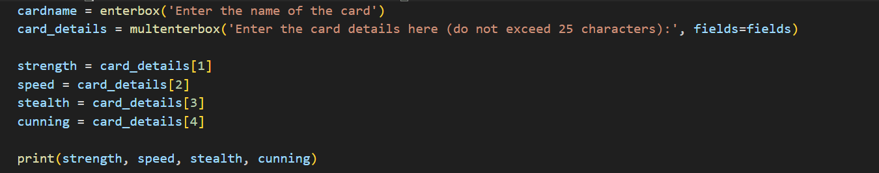
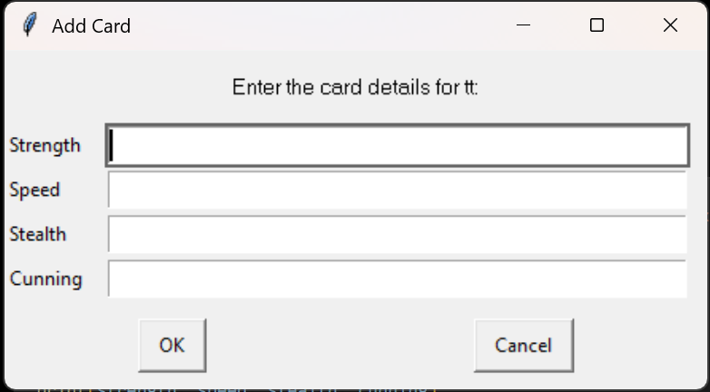
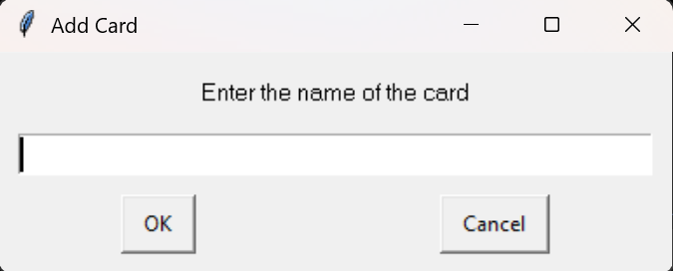


Add item – v6
In version 6 of the program, I separated the dictionary name from the abilities multenterbox in the user entry, that way if the user enters the wrong digit in the ability entries, they won’t have to retype the name

Slide 14
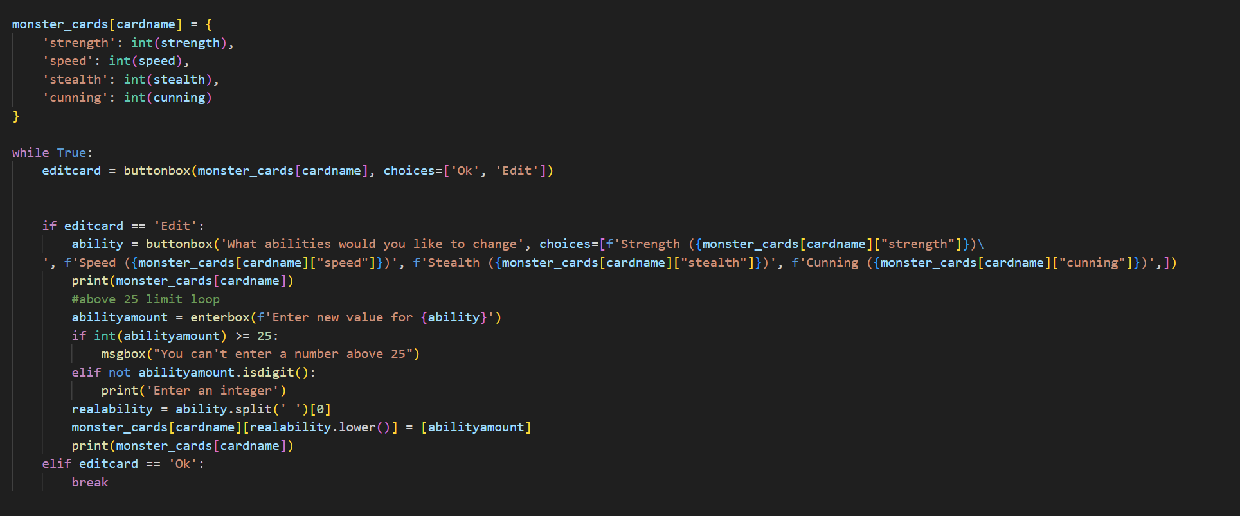
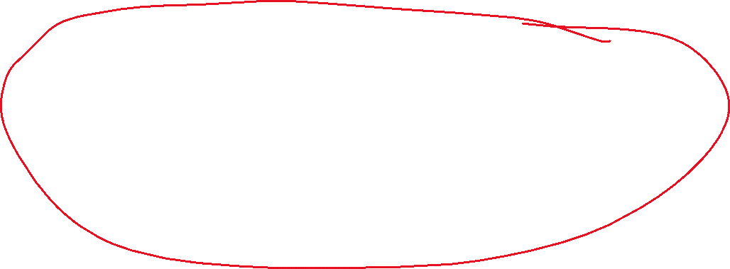
Add item – v7
In v7 of the program, I allowed the user to go back and edit what data they entered to allow them to correct mistakes. I simply copied the code from ‘searchitem’ program and pasted it in, and debugged it where necessary.

Slide 15
Add item – trialling conclusion
As the program developed, the trial with the multienterbox worked the best as it meant the user could enter multiple items at once – saving time. The program also improved throughout the trials.

Slide 16
Add entry- Test Plan
Additional rows can be added by clicking in the last cell and then using the Tab key
Test Cases – input | Expected output
A number below 25 and above zero | A new item in the dictionary
A number above 25 | The program to throw an error and ask the user to re-enter the number
Notes:
Additional rows can be added by clicking in the last cell and then using the Tab key

Slide 17
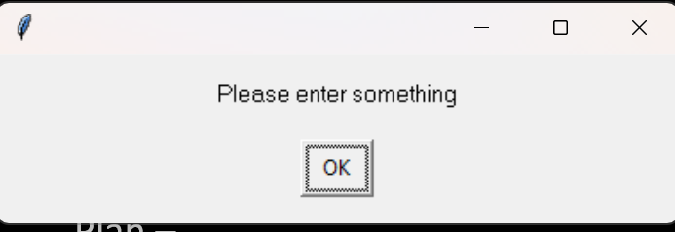
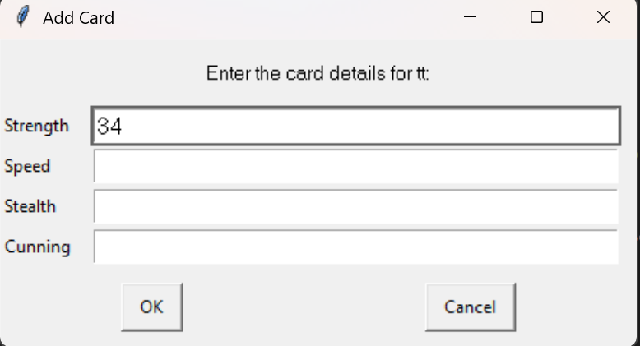
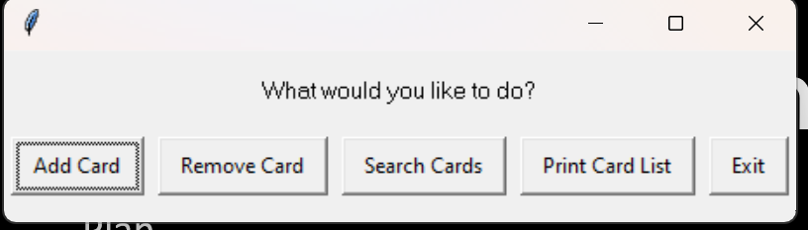
Add entry - testing
Plan –
enter a number above 25 and leave fields blank to show the program can error-check numbers
Cancel the additem process halfway through to show the program is resilient
Results: Program promps user to enter data again after the purposefull errors – success.

Slide 19
Search for item

Slide 20
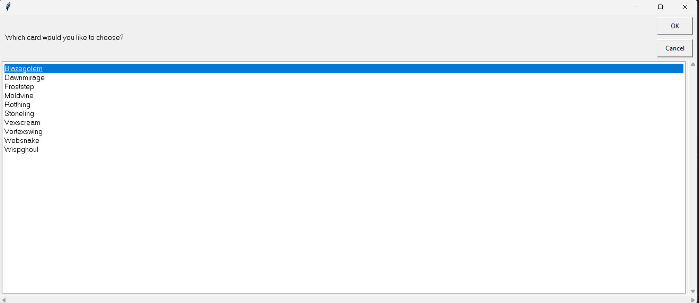
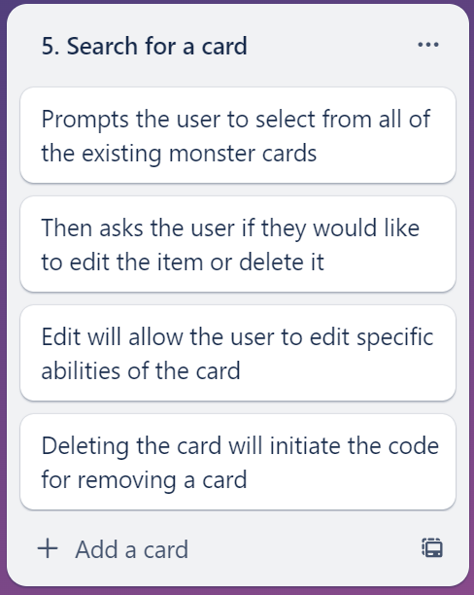
Search for an item
The ‘search for item’ component allows the user to search for a particular card in the monster_cards dictionary, allowing the user to then edit, or delete that particular card. The cards the user can search from are displayed in an easygui chiocebox.

Slide 21
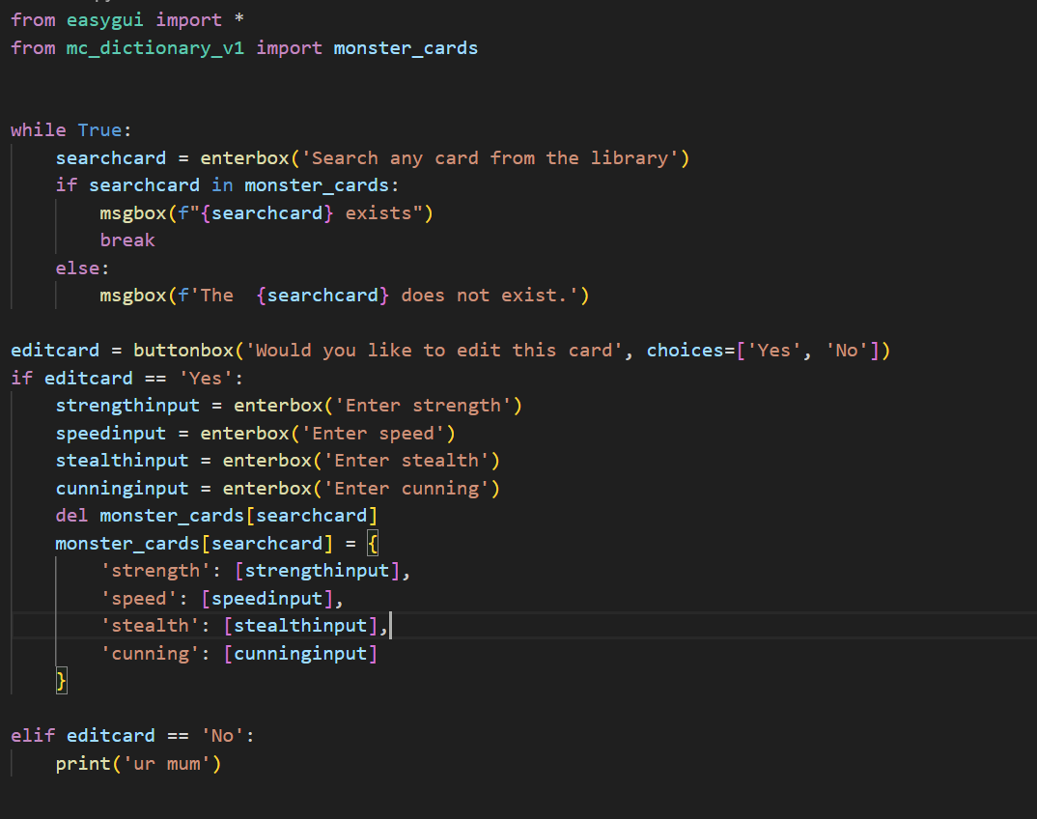
Search for item – Trialing (v.1)
To start off with, for searching for an item, I got the searchcard variable to define the user’s input for the search query. I then got an if loop to confirm if the item the user searched was in the dictionary
For the editcard section, I got the user’s input of the now determined ‘correct card’ to delete the dictionary entry, and for the user to enter the speed, stealth and strength again to effectively delete the dictionary entry and create a new one with the same name however the user appended abilities.

Slide 22
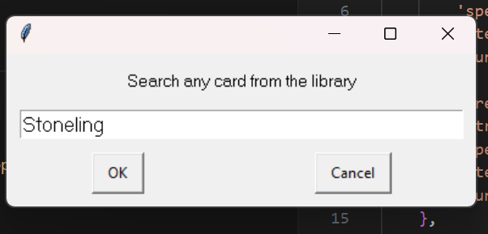
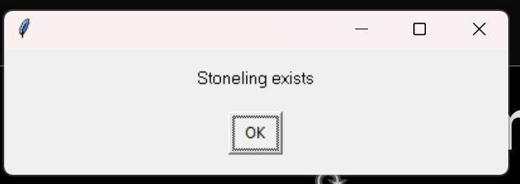
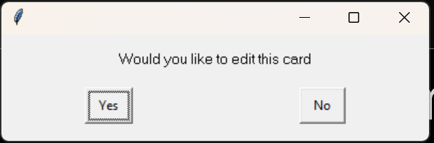
Search for item - Trialling
Before edit
After edit

Slide 23
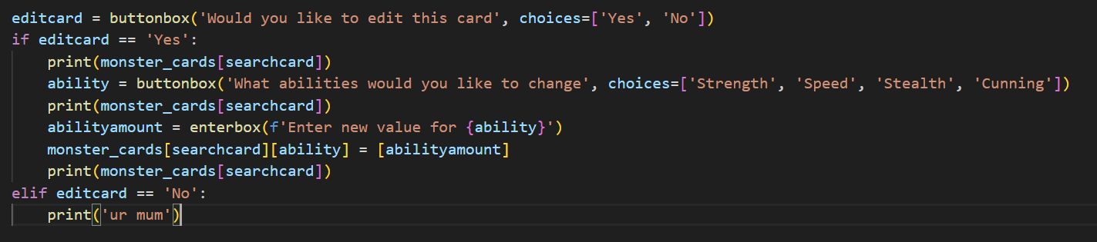
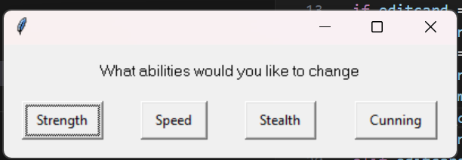
Search for item – Trialling (v3)
To make the edit process more intuitive, instead of deleting the whole list and creating it again, therefore getting the user to input all of the values again, I made a process where an easygui prompt will give the user an option on what specific ability to edit, instead of redoing all of the abilities.
However the buttonbox was creating a new entry called ‘Speed’ rather than adding an entry to the existing ‘speed.’ However everything else was working as intended

Slide 24
Search for item - Trialling
Adding a .lower to the end of ability solved the problem

Slide 25
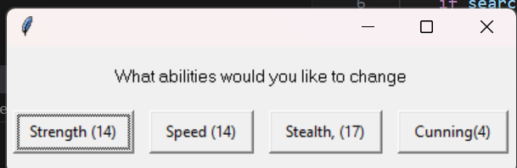
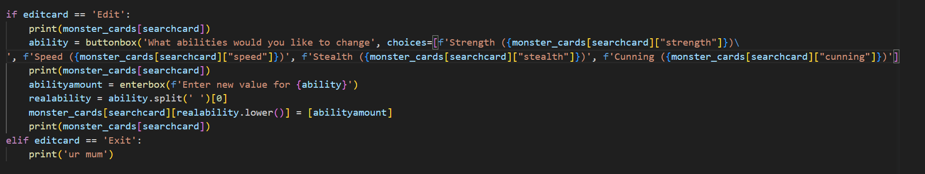
Search for item – Trialling (v4)
In version 4 of the program component, I created the ability selection buttons to have the amount of ability beside them
I achieved this by first splitting the ability and the current number using an ability.split command. That split the ability from the associated number. The lower case made the capital letter at the start of the word lower.

Slide 26
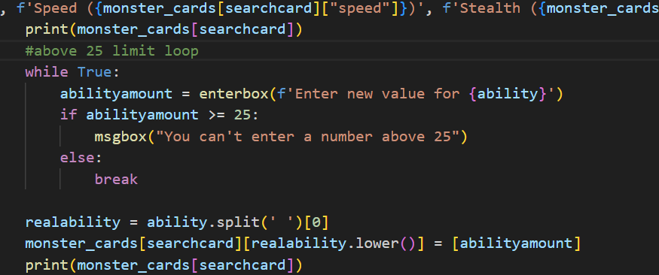
Search for item – Trialling (v5)
In v5, I created the above 25 limiter, to limit the user to entering a number above 25, and the program throwing up an error when the user does so.

Slide 27
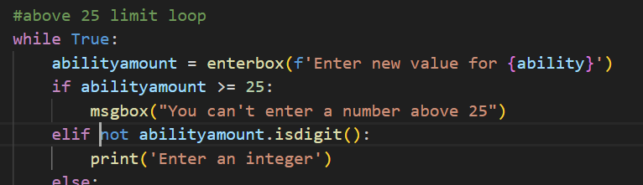
Search for item – Trialling (v5)
Adding an ‘isdigit’ string ensures if the user enters a string/letter instead of an integer, the program throws up an error.

Slide 28
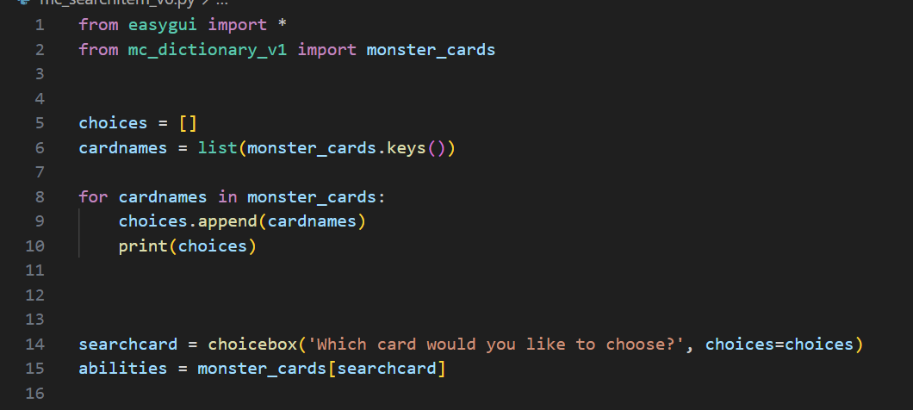
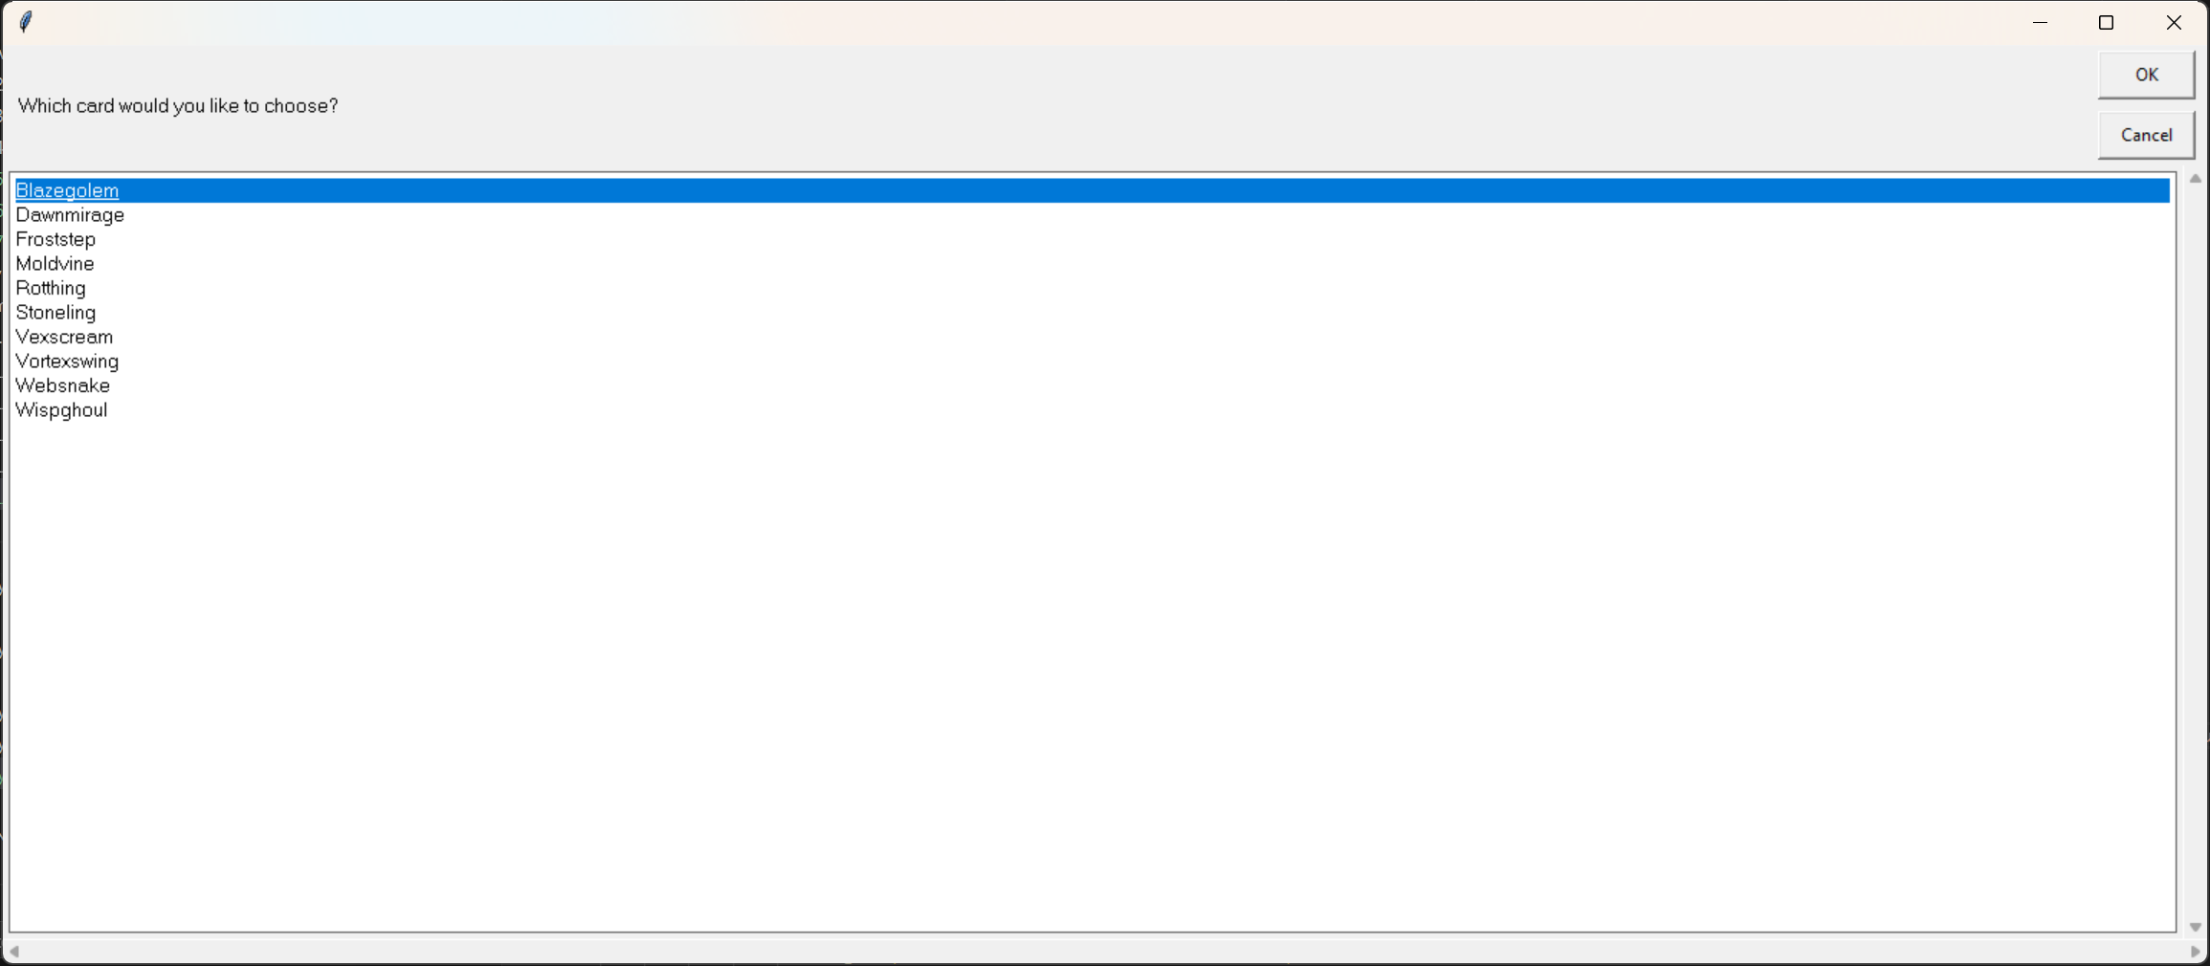
Search for item – trialling (v6)
In version 6 of the program, I changed the ‘search for item’ enterbox to a choicebox, where it displays all of the dictionary ‘keys’ or each of the cards in one box. This replaces where the user searches for a card where in some instances they might not know what card they are searching for. This way, all the cardnames are displayed in a chiocebox so the user can view the card’s abilities before they edit them

Slide 29
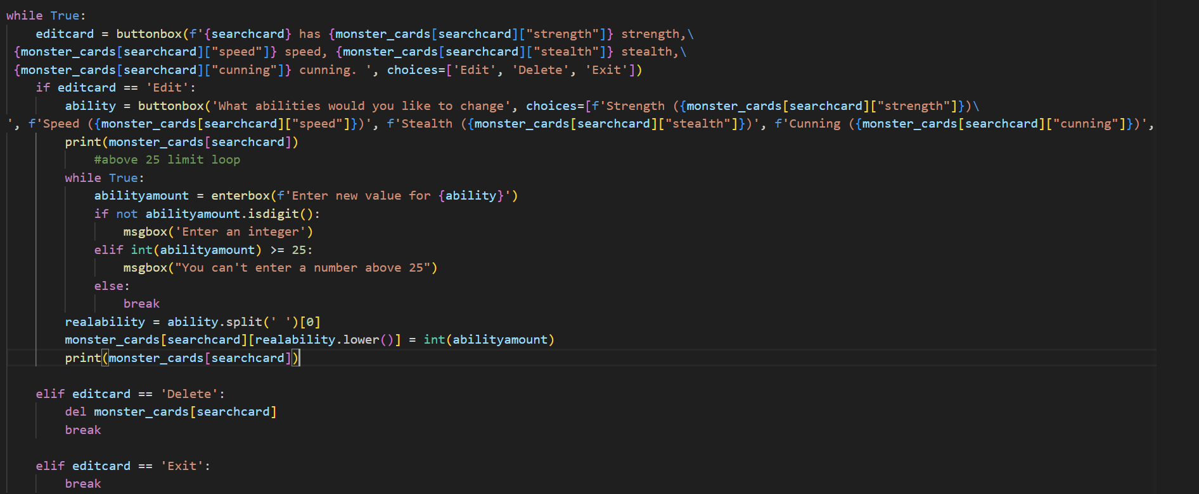
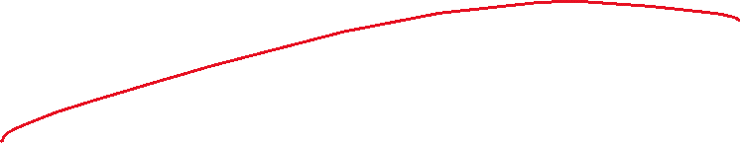
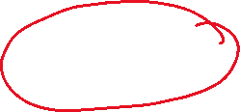
Search for item – trialling (v6)
I also built in delete functionality to the search program (refer to delete component)

Slide 30
Search for item – trialling conclusion
I cloncluded that the final version of the ‘search for item’ program is the best because searching for an item when you don’t know what the items are inconveniences the end user. Therefore the ‘choicebox’ displaying all of the dictionary entries in one place for the user to choose from made more sense.

Slide 31
Search for item - Test Plan
Test Cases – input | Expected output
No items in the choicebox | The program to throw an error to the user and the program to return to the homescreen
(Editing the searched item) A number above 25 for abilities | The program to tell the user to enter a number below 25
A STRING | The program to tell the user to enter not a string
Cancel button pressed | The program to return to welcome_options
Notes:
Additional rows can be added by clicking in the last cell and then using the Tab key

Slide 32
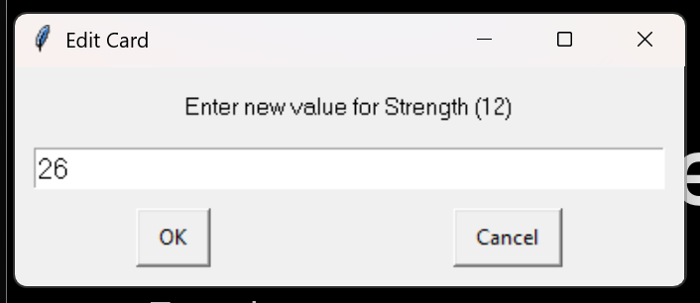
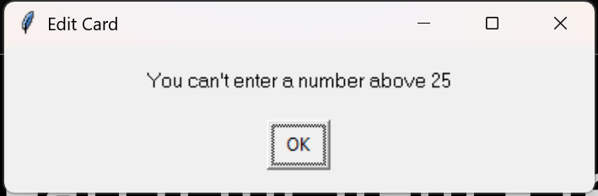
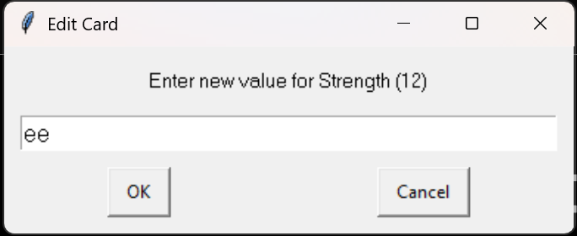
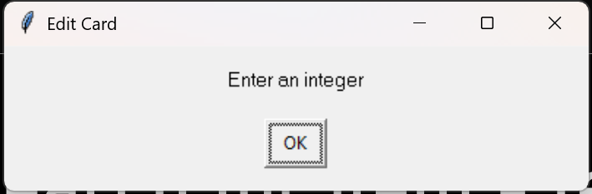
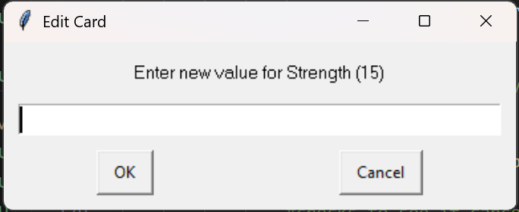
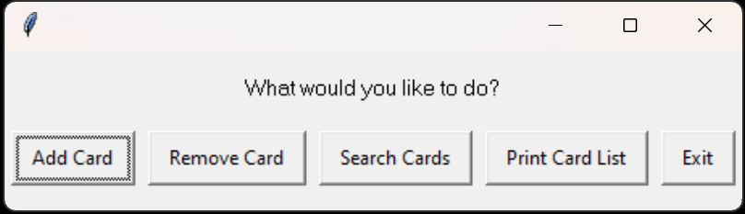
Search for item - testing
Test plan:
A number above 25 for abilities
A STRING
Cancel button pressed
Results:
If a number above 25 is entered, the program throws an error and re-prompts the user to enter a number
If a string is entered, the program will throw an error and re-prompt the user to enter a number
If cancel button is pressed the program will take you back to the menu - Success

Slide 33
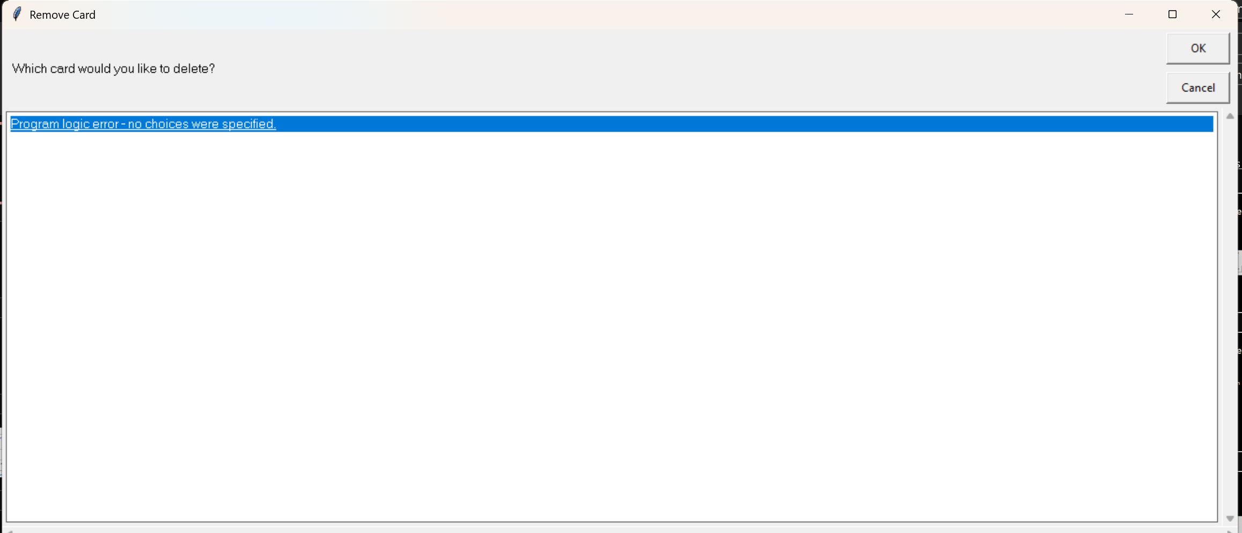
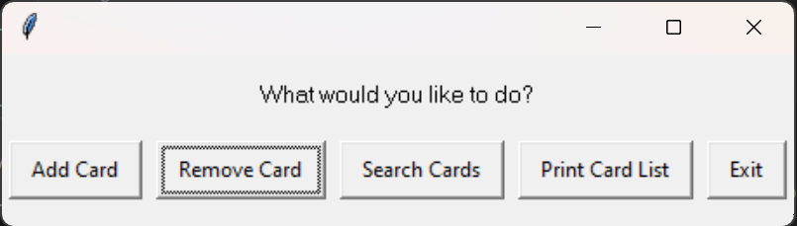
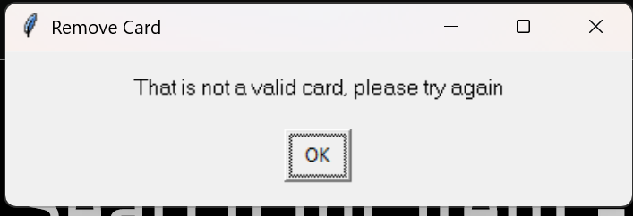
Search for item - Testing
Test results: goes back to menu: success!
Test plan –
Delete all items in the list to show the program can deal with no items in the list

Slide 35
Delete Item

Slide 36


Delete Item
The delete item component deletes a dictionary entry – either built in entry or a user created one – out of the dictionary. This allows the user to remove undesired and unnecessary items from the dictionary.

Slide 37
Delete Item- Test Plan
Test Cases – input | Expected output
Deleting an item | The item to be deleted on the list
Cancel button pressed | The program returning to welcome_options menu
Notes:
Additional rows can be added by clicking in the last cell and then using the Tab key

Slide 38
Delete Item- testing

Slide 40
Print card list

Slide 41






Print card list
This code prints what’s currently in the dictionary to the console. This allows the user to have the raw data for them to do what they would like with it as they can easily copy and paste off the terminal.

Slide 43
[Component name]: Testing
You must show the results of testing. For each component, include a screenshot proving it works. You can also include notes about each test.
Notes:
You must show the results of testing. For each component, include a screenshot proving it works. You can also include notes about each test.

Slide 44
Assembled Outcome Testing:
Show testing for your assembled outcome below. This should include a test plan followed by screenshot proof.
Notes:
Show testing for your assembled outcome below. This should include a test plan followed by screenshot proof.

Slide 45
Address relevant Implications:
Relevant implication | Explain how your final outcome addresses each implication

Slide 46
Version Control Evidence:
Your version control evidence should go here. This could be in the form of screenshots (both of your GitHub repository as well as your local project folder) as evidence of your incremental development.
Notes:
Your version control evidence should go here. This could be in the form of screenshots (both of your GitHub repository as well as your local project folder) as evidence of your incremental development.

Slide 47
Final Discussion:
Discuss how the information from planning, testing and trialling of components assisted in the development of a high-quality outcome.
Notes:
Discuss how the information from planning, testing and trialling of components assisted in the development of a high-quality outcome.

